Slide 1
Lending ASSETs in The Sandbox Proposal
A (kinda) rip-off Aave for the Sandbox (but not really)

Slide 2
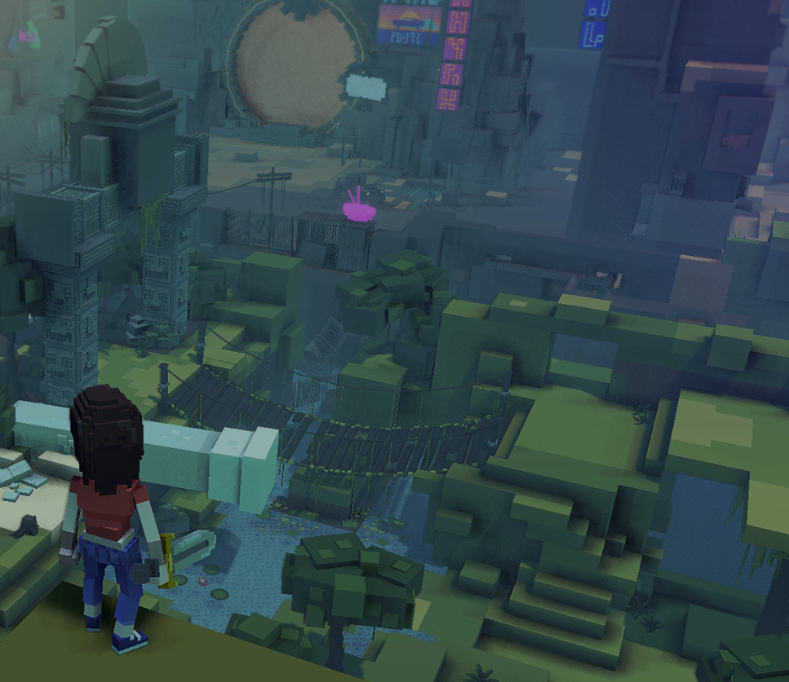

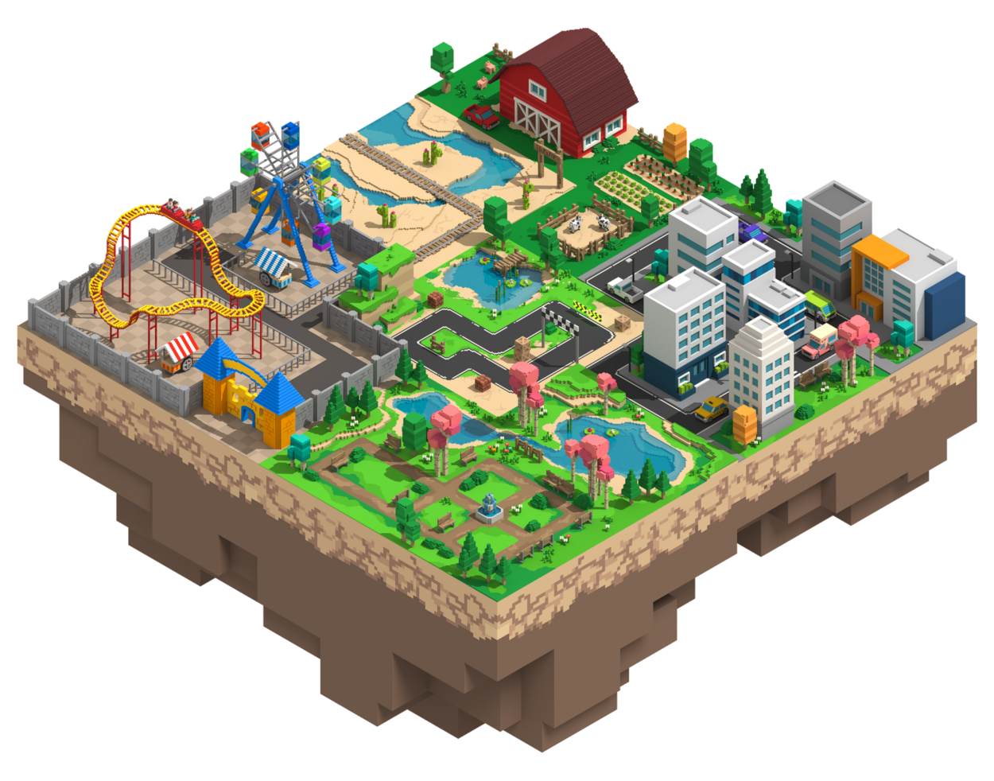

Quick Primer on The Sandbox
“A Decentralized gaming platform made by players”
“The Sandbox is a virtual world [metaverse] where players can buil, own, and monatize their gaming experiences in the Ethereum blockchain using $SAND, the main utility token of the platform
https://installers.sandbox.game/The_Sandbox_One_Pager_2020.pdf

Slide 3
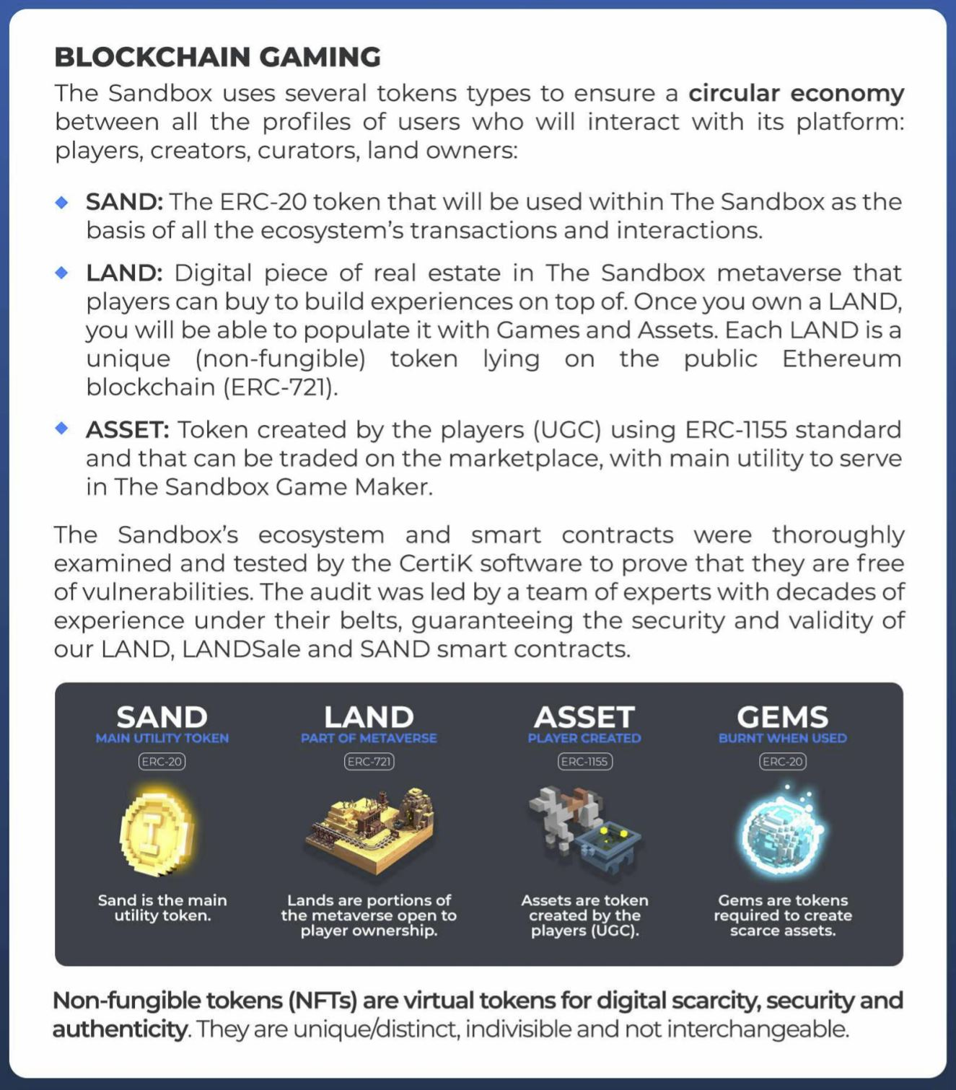
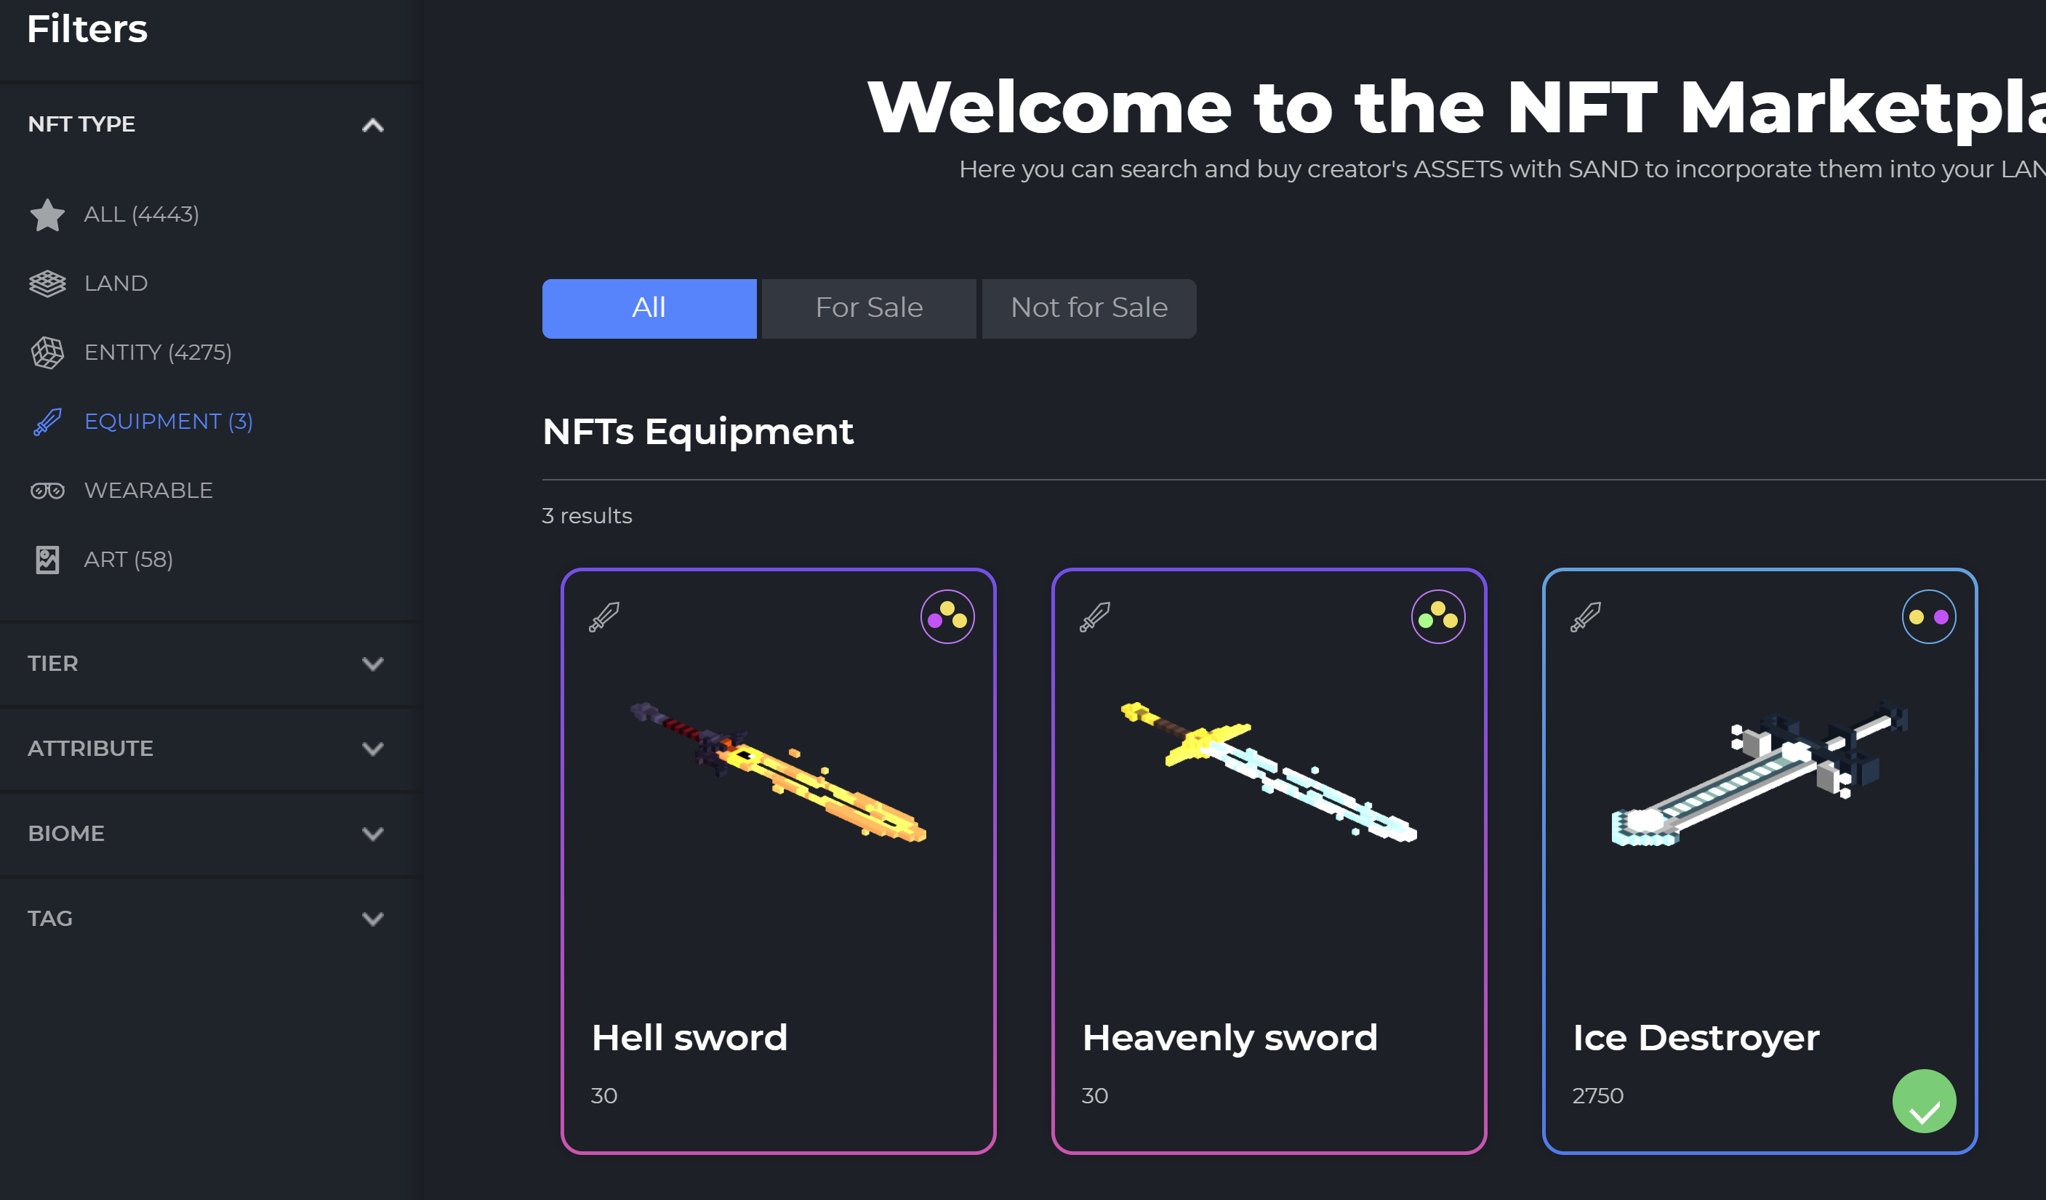
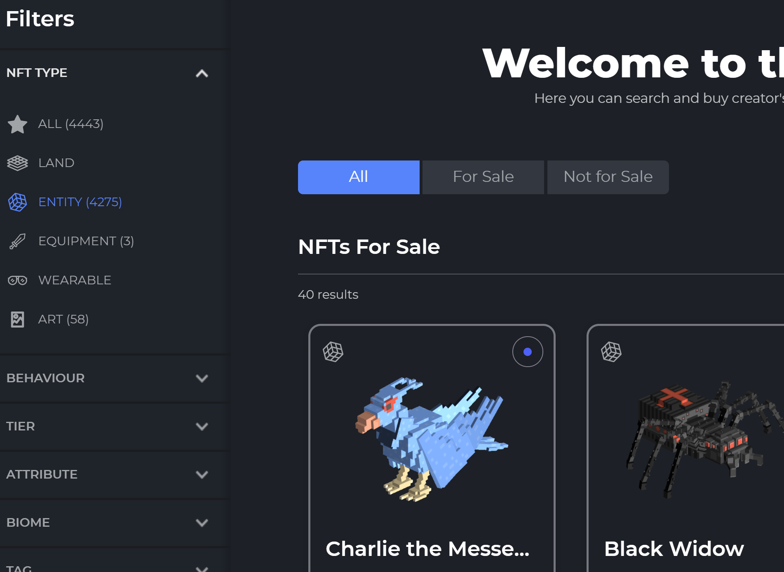
Bits we acc care about:
$SAND is currency used by the Sandbox
Assets are “items”, including wearables, equipment, art & entities
https://installers.sandbox.game/The_Sandbox_One_Pager_2020.pdf

Slide 4
Lender
Our System
Borrower
ASSET POOL
Collat POOL
ASSET + % profit from Borrowing
%deposit of $SAND as Collat
ASSET
ASSET + Terms
ASSET + Fee
Deposit

Slide 5
Real World Example/Explanation of Process

Slide 6

Lender
Our System
Borrower
I have diamond sword (worth X sand) I am currently not using or planning to use for next three weeks
I am willing to loan this for 20$sand per day with 90% of X as Collat
Diamond Sword

Slide 7
Lender
Our System
Borrower
Diamond Sword
20 sand per day
90% Collat

Slide 8
Lender
Our System
Borrower
Diamond Sword
20 sand per day
90% Collat

Slide 9
Lender
Our System
Borrower
I cannot afford Diamond sword but I need it to complete a quest
I do have 90% of sword value in sand and willing to pay 20 sand for the day/s I use it
Diamond Sword
20 sand per day
90% Collat

Slide 10
Lender
Our System
Borrower
Diamond Sword
20 sand per day
90% Collat
90% Value of X in sand (diamond sword val)

Slide 11
Lender
Our System
Borrower
Diamond Sword
ASSET

Slide 12
Lender
Our System
Borrower
*does quest*
Diamond Sword

Slide 13
Lender
Our System
Borrower
Ok I am now done with sword
Diamond Sword
Diamond sword + 20 sand

Slide 14
Lender
Our System
Borrower
Ok I am now done with sword
Diamond Sword
20 sand per day
90% Collat

Slide 15
Lender
Our System
Borrower
Diamond Sword
20 sand per day
90% Collat
Collat

Slide 16
Lender
Our System
Borrower
Ok I am now done with sword
Diamond Sword
20 sand per day
90% Collat
3 Weeks pass

Slide 17
Lender
Our System
Borrower
Diamond sword + 20 sand per day of rental use
Diamond Sword

Slide 18
Lender
Our System
Borrower
Diamond Sword
I got sword back and got some money for some random using it

Slide 19
What if Borrower steals ASSET?

Slide 20
Lender
Our System
Borrower
*steals item*
Diamond Sword

Slide 21
Lender
Our System
Borrower
Collat

Slide 22
Rough Designs

Slide 23
HOME
YOUR ITEMS
POOL
Connect Web3 Wallet

Slide 24
HOME
YOUR ITEMS
POOL
Connect Web3 Wallet
Nothing to see :(
Connect your MetaMask Wallet to see your items!

Slide 25
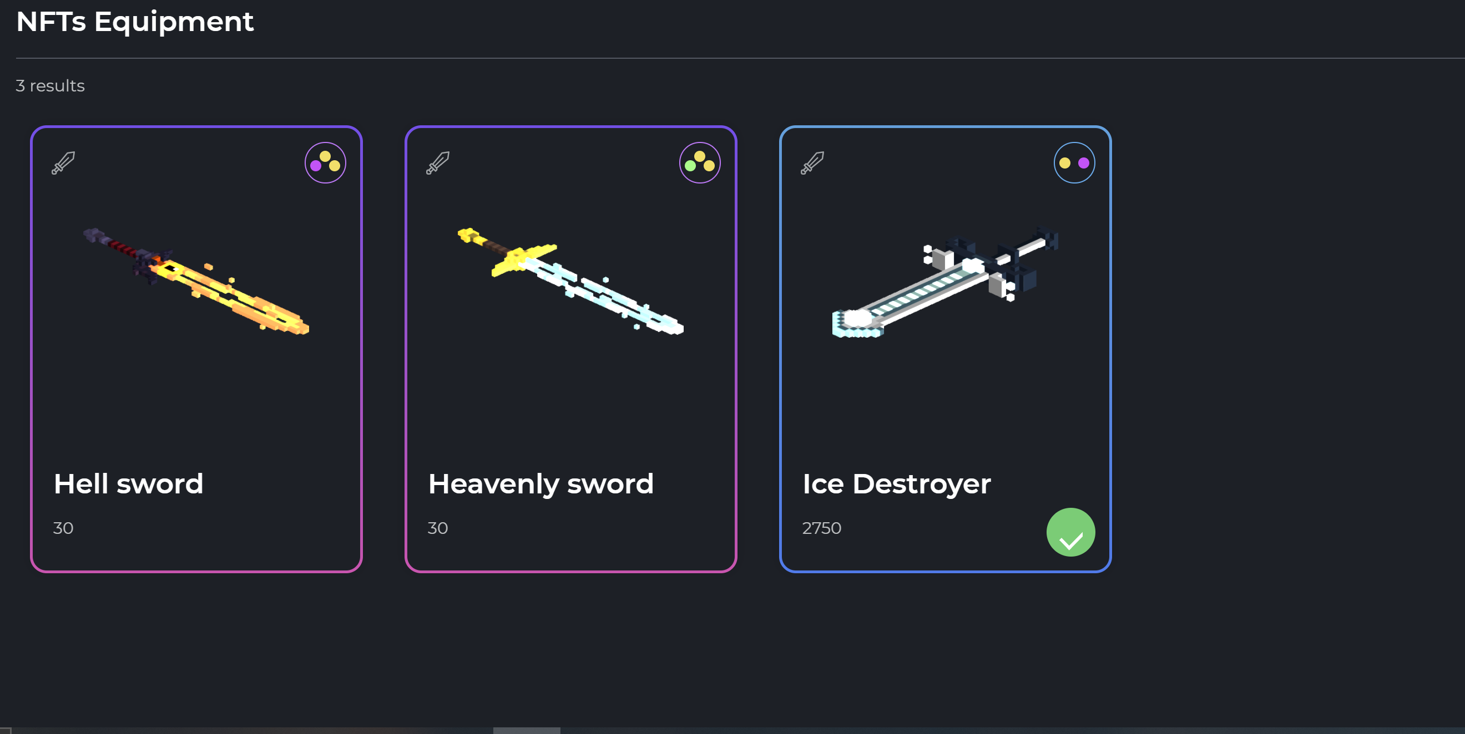
HOME
YOUR ITEMS
POOL
Connect Web3 Wallet
x $SAND Collat
y $SAND per day
x $SAND Collat
y $SAND per day
x $SAND Collat
y $SAND per day

Slide 26
HOME
YOUR ITEMS
POOL
Connected

Slide 27
HOME
YOUR ITEMS
POOL
Connected
Your Equipment

Slide 28
OWNED ITEM
Connected
HOME
YOUR ITEMS
POOL
Your Equipment
You are the OG owner :)
Terms:
Val of item:
% Collat:
$SAND per day:
Till:
Put item in pool

Slide 29
LENT ITEM
Connected
HOME
YOUR ITEMS
POOL
Your Equipment
OG Owner: z
Available till: d/m/y
Terms:
x $SAND Collat
y $SAND per day
Return Item for Collat return
RETURN BY:
d/m/y

Slide 30
HOME
YOUR ITEMS
POOL
Connected
x $SAND Collat
y $SAND per day
x $SAND Collat
y $SAND per day
x $SAND Collat
y $SAND per day

Slide 31
HOME
YOUR ITEMS
POOL
Connected
Owner: z
Available till: d/m/y
Terms:
x $SAND Collat
y $SAND per day
x $SAND Collat
y $SAND per day
x $SAND Collat
y $SAND per day
x $SAND Collat
y $SAND per day
Deposit x amount and agree to terms

Slide 32
Rough Mock-Up of UI Flow/Process
(this is just a borrowing example, interface as lender is semi above)

Slide 33
HOME
YOUR ITEMS
POOL
Connect Web3 Wallet

Slide 34
HOME
Click
Connect Web3 Wallet
YOUR ITEMS
POOL

Slide 35
HOME
YOUR ITEMS
POOL
Connect Web3 Wallet
Nothing to see :(
Connect your MetaMask Wallet to see your items!

Slide 36
HOME
YOUR ITEMS
Click
Connect Web3 Wallet
POOL
Nothing to see :(
Connect your MetaMask Wallet to see your items!

Slide 37
HOME
YOUR ITEMS
POOL
Connect Web3 Wallet
x $SAND Collat
y $SAND per day
x $SAND Collat
y $SAND per day
x $SAND Collat
y $SAND per day

Slide 38
Click
HOME
YOUR ITEMS
POOL
Connect Web3 Wallet

Slide 39
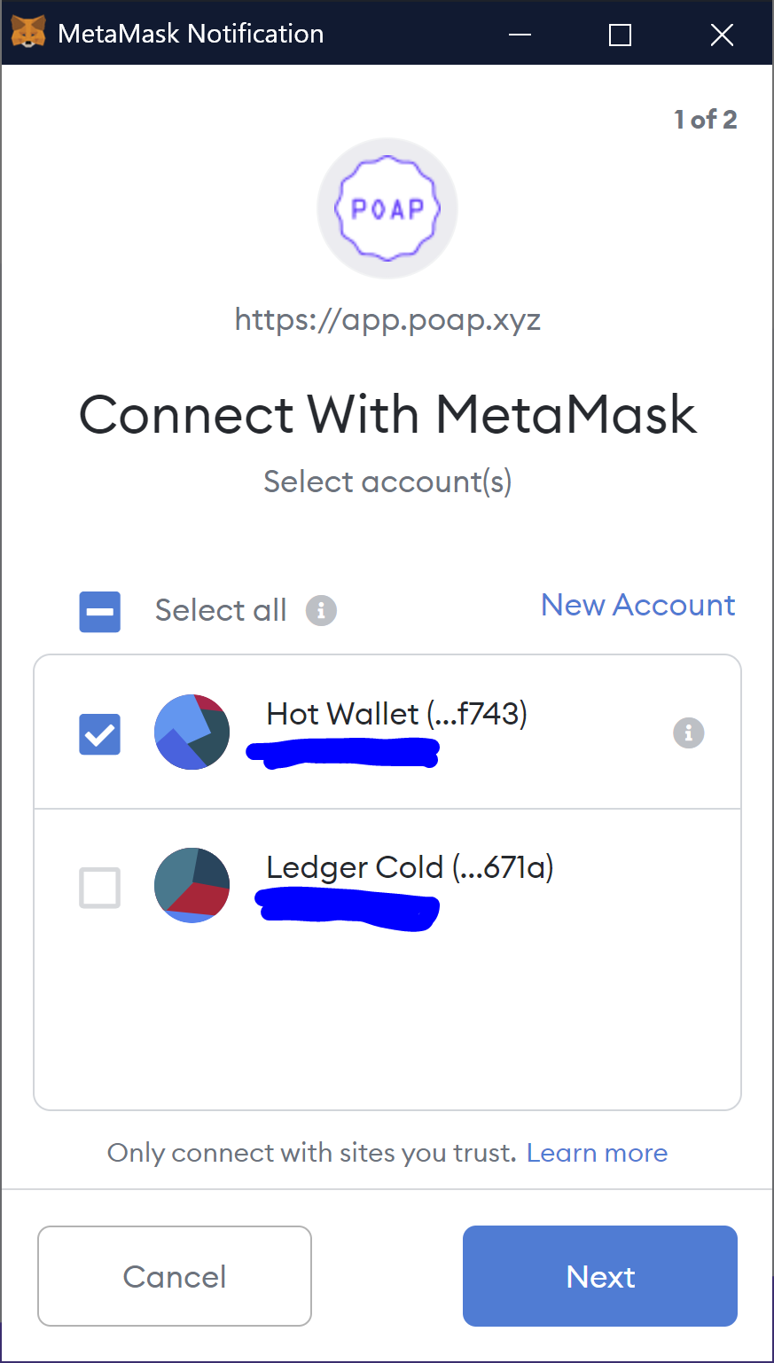
HOME
YOUR ITEMS
POOL
Connect Web3 Wallet
Click

Slide 40
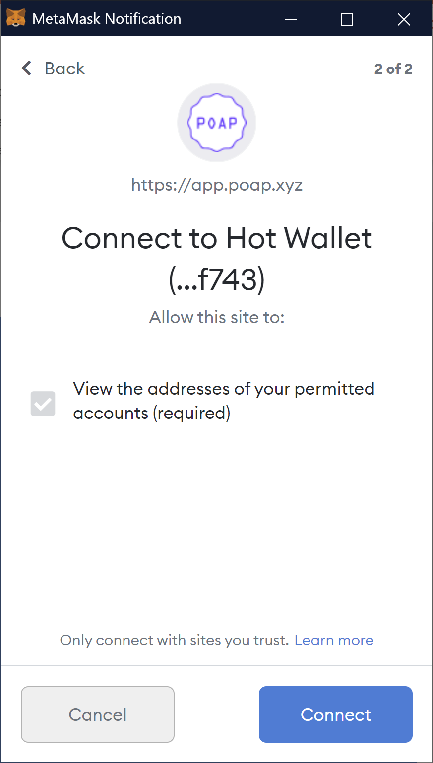
HOME
YOUR ITEMS
POOL
Connect Web3 Wallet
Click

Slide 41
HOME
Click
Connected
YOUR ITEMS
POOL

Slide 42
HOME
YOUR ITEMS
POOL
Connected
Your Equipment

Slide 43
HOME
YOUR ITEMS
Click
Connected
POOL
Your Equipment

Slide 44
HOME
YOUR ITEMS
POOL
Connected
x $SAND Collat
y $SAND per day
x $SAND Collat
y $SAND per day
x $SAND Collat
y $SAND per day

Slide 45
HOME
YOUR ITEMS
POOL
Connected
Click
x $SAND Collat
y $SAND per day
x $SAND Collat
y $SAND per day
x $SAND Collat
y $SAND per day

Slide 46
HOME
YOUR ITEMS
POOL
Connected
Owner: z
Available till: d/m/y
Terms:
x $SAND Collat
y $SAND per day
x $SAND Collat
y $SAND per day
x $SAND Collat
y $SAND per day
x $SAND Collat
y $SAND per day
Deposit x amount and agree to terms

Slide 47
HOME
YOUR ITEMS
POOL
Connected
Owner: z
Available till: d/m/y
Terms:
x $SAND Collat
y $SAND per day
x $SAND Collat
y $SAND per day
x $SAND Collat
y $SAND per day
x $SAND Collat
y $SAND per day
Click
Deposit x amount and agree to terms

Slide 48
HOME
YOUR ITEMS
POOL
Connected
Your Equipment

Slide 49
HOME
YOUR ITEMS
POOL
Connected

Slide 50
HOME
YOUR ITEMS
POOL
Connected
Your Equipment

Slide 51
HOME
YOUR ITEMS
POOL
Connected
Your Equipment
OG Owner: z
Available till: d/m/y
Terms:
x $SAND Collat
y $SAND per day
Return Item for Collat return

Slide 52
HOME
YOUR ITEMS
POOL
Connected
Your Equipment
OG Owner: z
Available till: d/m/y
Terms:
x $SAND Collat
y $SAND per day
Click
Return Item for Collat return

Slide 53
Warnings for over-collateralising and under-collateralizing
Keep most things off chain, keep costs low af
Just try to get to MVP
By giving users choices in whether to over/under collat. They take on the risk etc [big clear warning button lol]
Could offer aTokens (like Aave) to give more confidence in lending?
Questions for us to consider
Just target Equipment rn?
Maybe fork the current marketplace?
Ui should be similar to Sandbox? Maybe different?
Can we acc do it? Lol
What fee cut do we take? (I think 1-5%)
Any name ideas lmao
Should we allow multiple listings of same asset (ie 20 sand per day for 110% OR 30 sand per day for 90%
Need maybe 1 more back end to help with smart contracts/database etc
Other Things to note;
When I say ASSETS in this pres. I’m mostly talking about equipment as this is the best example of why you would use this but I guess you could also use this for the other ASSETS(art, entities, wearables, etc) I just don’t really see a value in doing this??
Currently gameplay isn’t acc active so this is all kinda pointless but could be a cool proof of concept etc

Slide 54
Useful links general:
https://www.sandbox.game/
https://sandboxgame.gitbook.io/the-sandbox/
https://medium.com/sandbox-game
https://installers.sandbox.game/The_Sandbox_Whitepaper_2020.pdf
https://medium.com/sandbox-game/erc-1155-a-new-standard-for-the-sandbox-c95ee1e45072
https://medium.com/sandbox-game/user-generated-contents-meets-nfts-within-the-sandbox-4b865966c54e
Contract Addresses/OpenSea etc
https://etherscan.io/token/0x3845badAde8e6dFF049820680d1F14bD3903a5d0 - sand token address
https://etherscan.io/token/0x50f5474724e0ee42d9a4e711ccfb275809fd6d4a#balances – land address, might not be useful
https://etherscan.io/address/0xa342f5d851e866e18ff98f351f2c6637f4478db5#readProxyContract
https://opensea.io/assets/0xa342f5d851e866e18ff98f351f2c6637f4478db5/40785833732304342849735419653626615027421227776496020677721887159020450484224
Code Links:
https://github.com/thesandboxgame/sandbox-smart-contracts
https://github.com/ethereum/eips/issues/1155
Competitors/Similar Projects
https://twitter.com/OortDigital - https://etherscan.io/address/0xa133541435caeb964f572132acd8feac3ed1d80b
https://github.com/oort-digital (FUCK)
https://docs.oortdigital.tech/
Socials
https://www.reddit.com/r/TheSandboxGaming/
https://discord.gg/STsVX5GPhz
https://medium.com/sandbox-game

Slide 55
